Slide 1
MV Vaporization

Slide 2
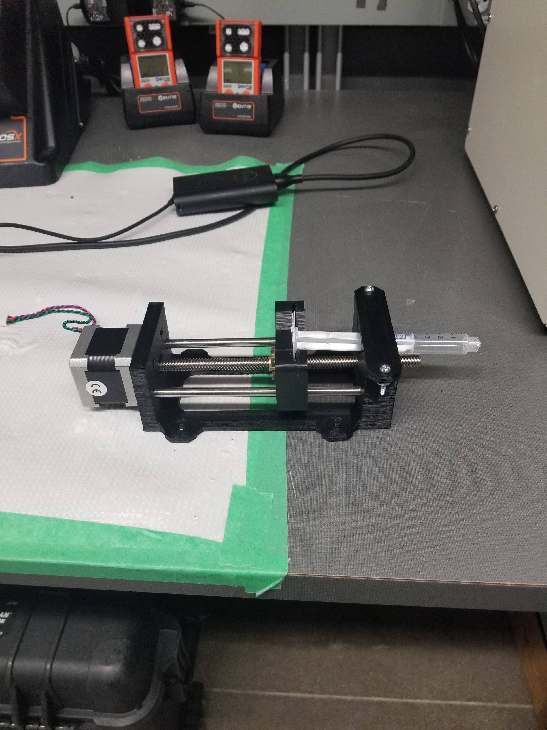
Syringe Pump Calibration
We have developed, and calibrated this syringe pump
It will allow for the accurate acquiring of samples
Works on 6V
Notes:
1- Syringe pump calibration

Slide 3
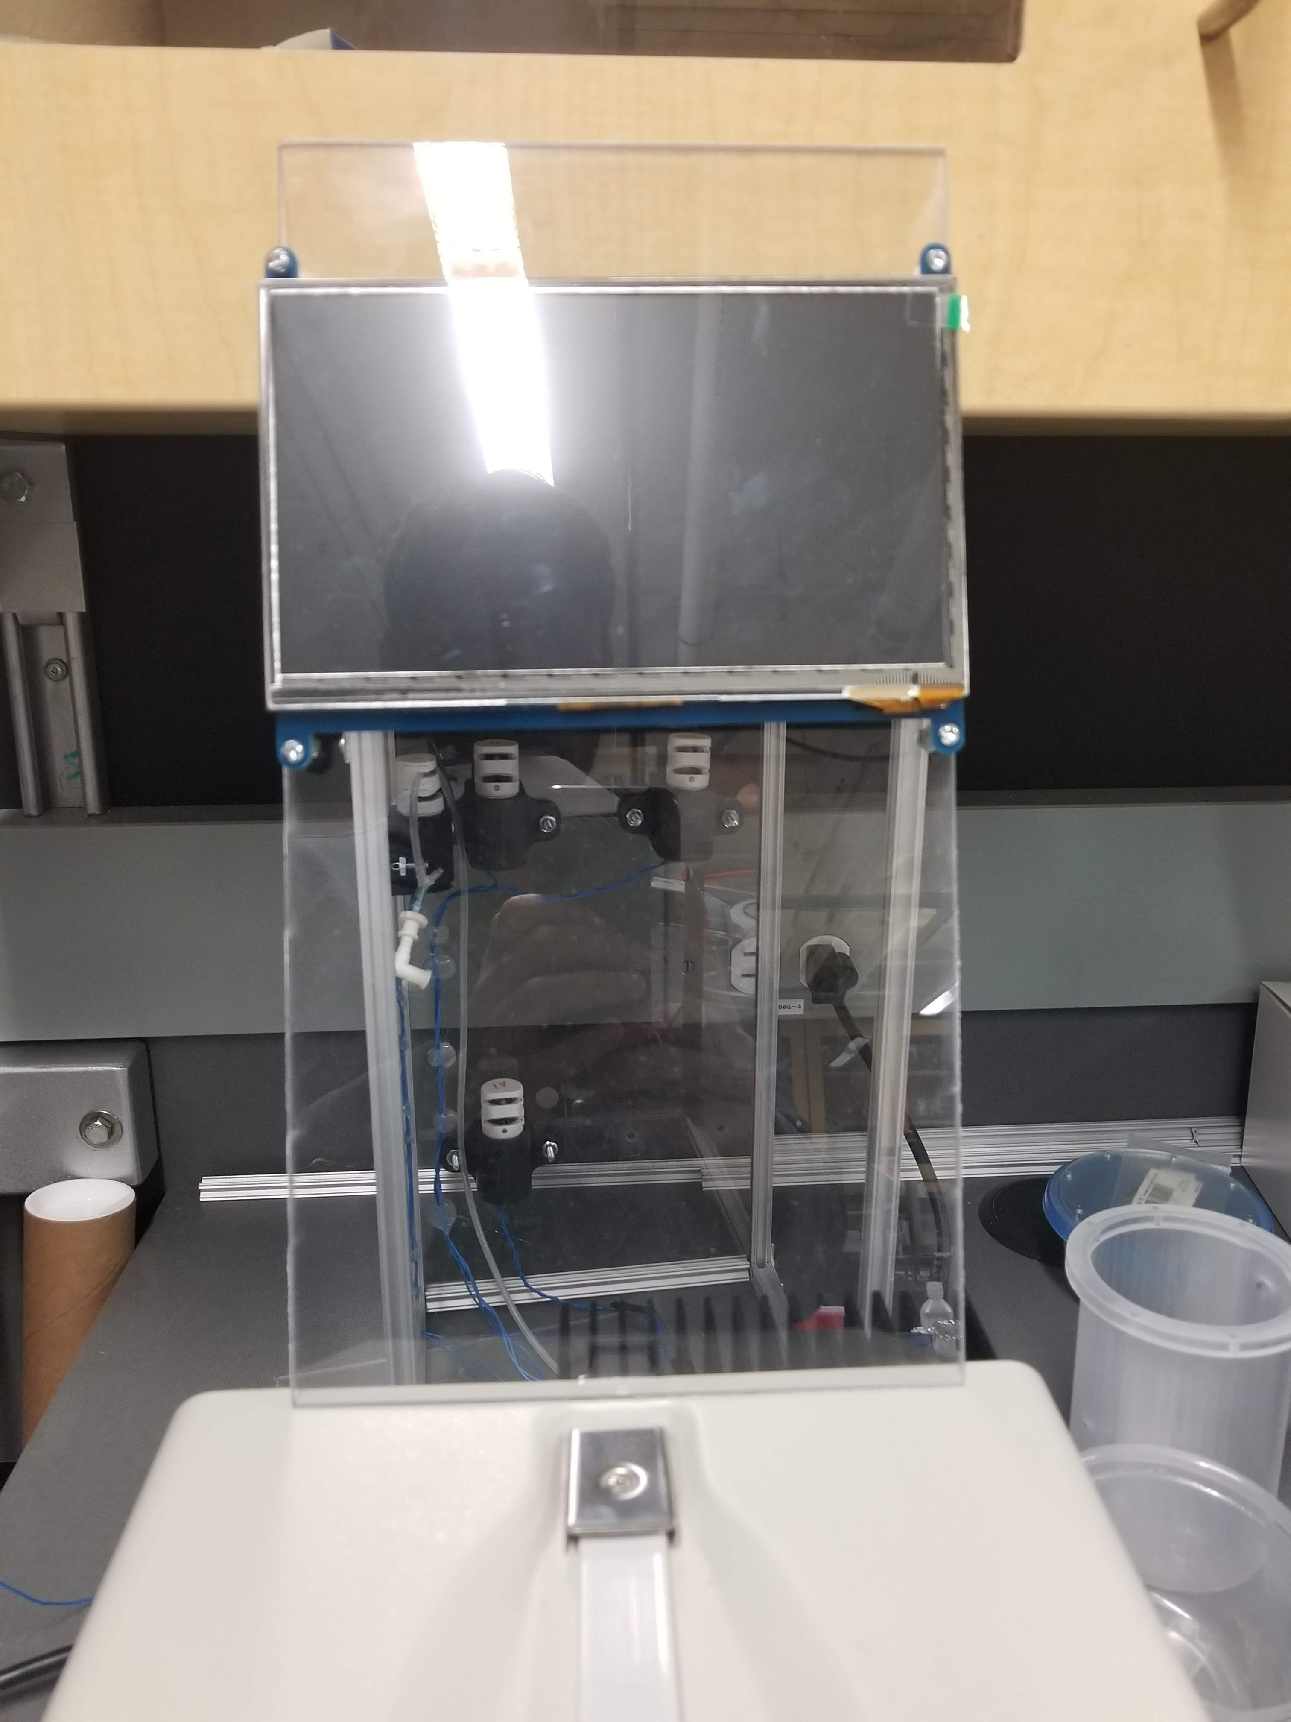
Testing and Calibrating the Setup
Test One- Setup the sensors and monitor conditions within the chamber
Test Two – Vaporization tests with DI Water
Determine Test length
Notes:
, 2- Sensors setup and test for monitoring temperature and humidity, 3- Vaporization tests with DI water and flushing chamber after vaporization to find vaporization time and identify potential issues.
The issues I noticed were that the parylene-C coating started to peel off from the inside of the chamber due to the high humidity, the glue holding the magnet got in contact with vapor and the magnet got loose.
We are looking for ways to solve these issues at the moment. Because it won't allow us to perform multiple tests over and over.

Slide 4
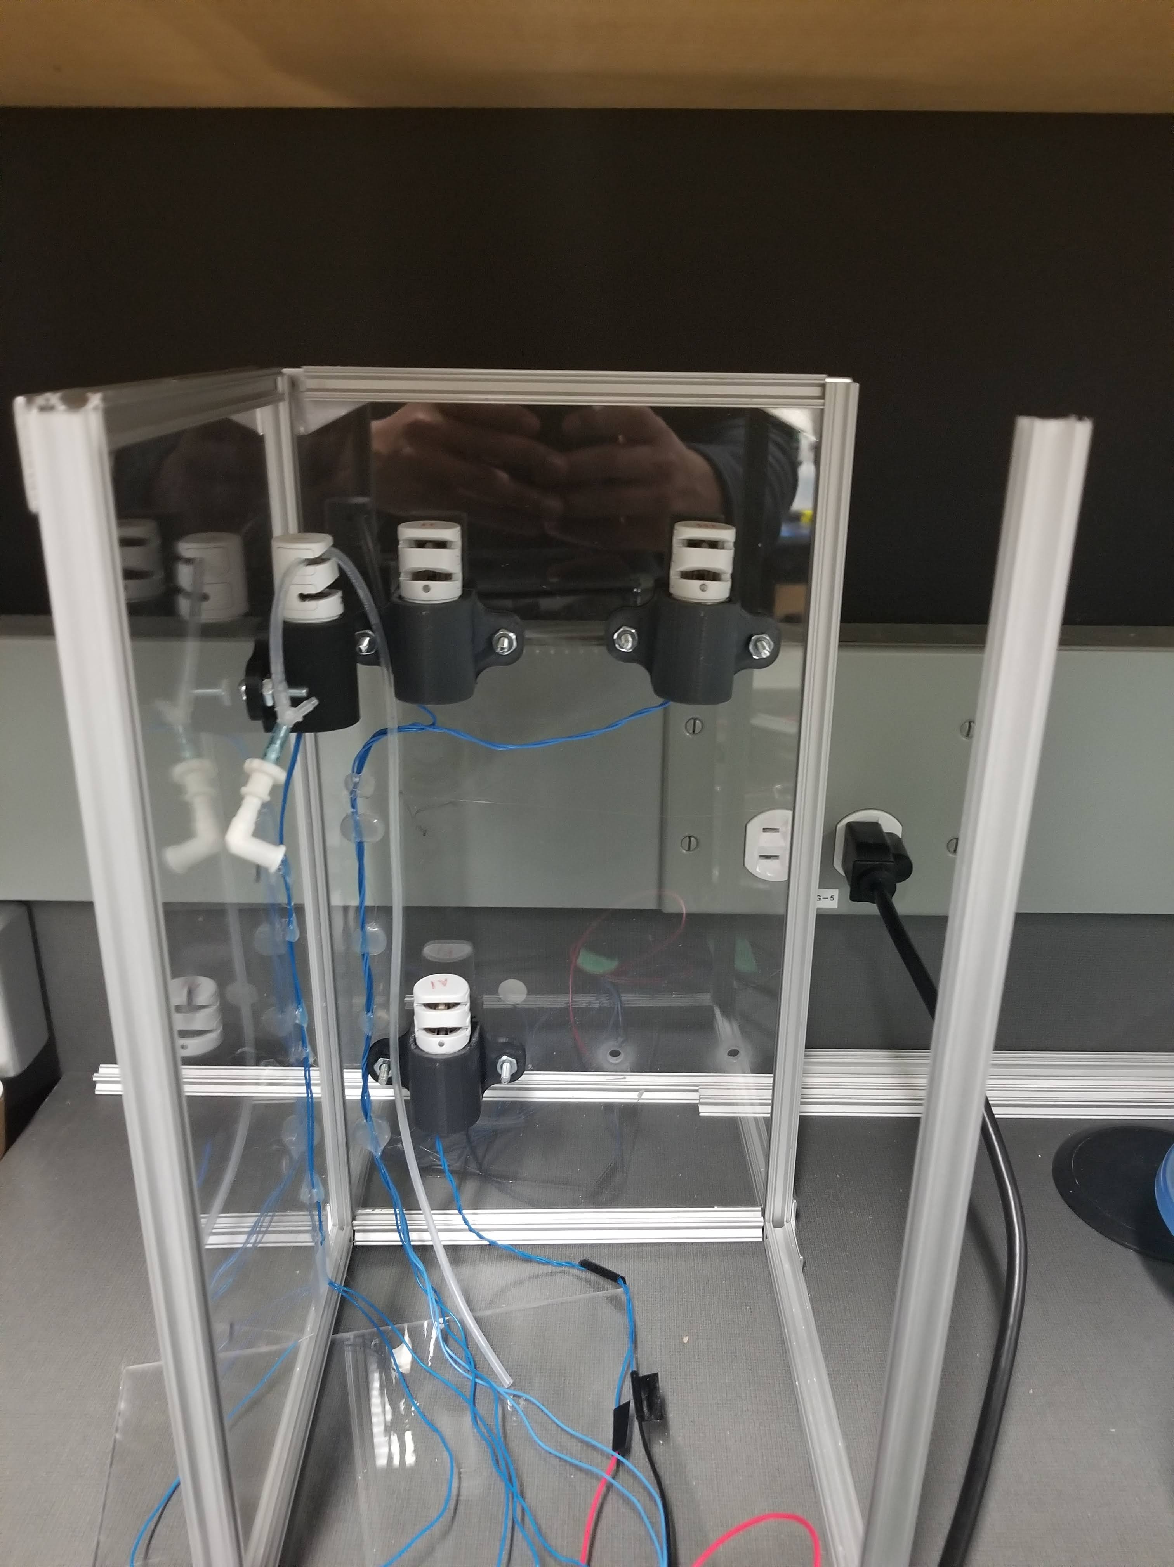
Areas to Develop
The chamber becomes saturated with vapor and results in damage to instruments, need to develop a more robust system
The sensor site is initially covered in Paralyne-C. This overtime gets eroded due to a combination of friction and humidity
The testing length needs to be finalized
GUI needs to be updated

